Slide 1
MetaVue VS3200
January 2018

Slide 2
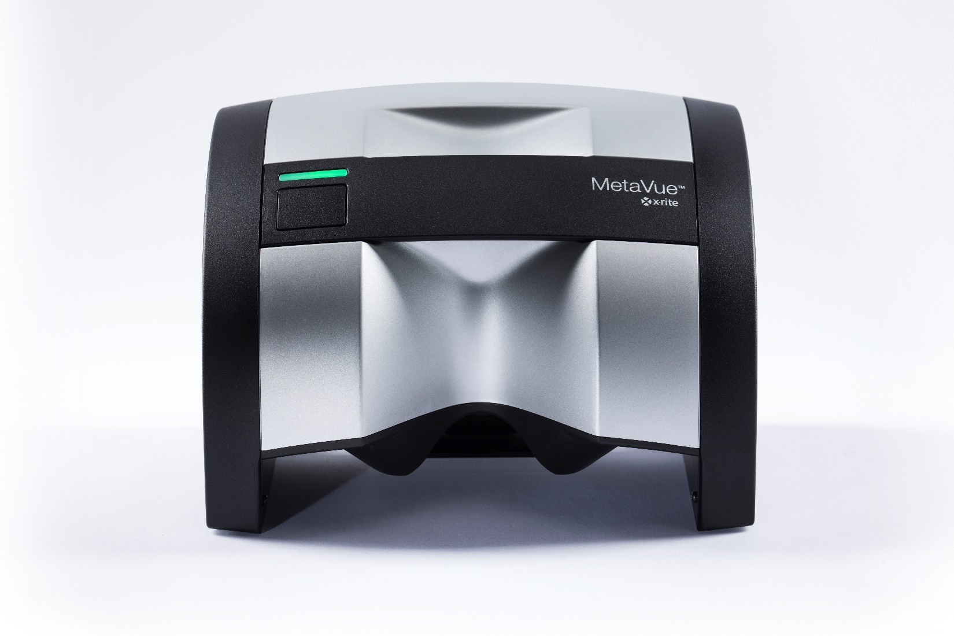
Overview
MetaVue VS3200
For industrial quality control and formulation
The MetaVue non-contact imaging spectrophotometer brings breakthrough versatility and accuracy to measurement of wet and dry paints, plastics, cosmetics, wet and odd-shaped samples.
Unmatched versatility
Superior measurement performance
Ease of use
Seamless integration
Notes:
The MetaVue VS3200 is designed for industrial quality control and formulation. It is a non-contact imaging spectrophotometer that brings breakthrough versatility and accuracy to measurement of wet and dry paints, plastics, cosmetics, wet and odd-shaped samples. The MetaVue’s key benefits include unmatched versatility, superior measurement performance, ease of use, and seamless integration.

Slide 3
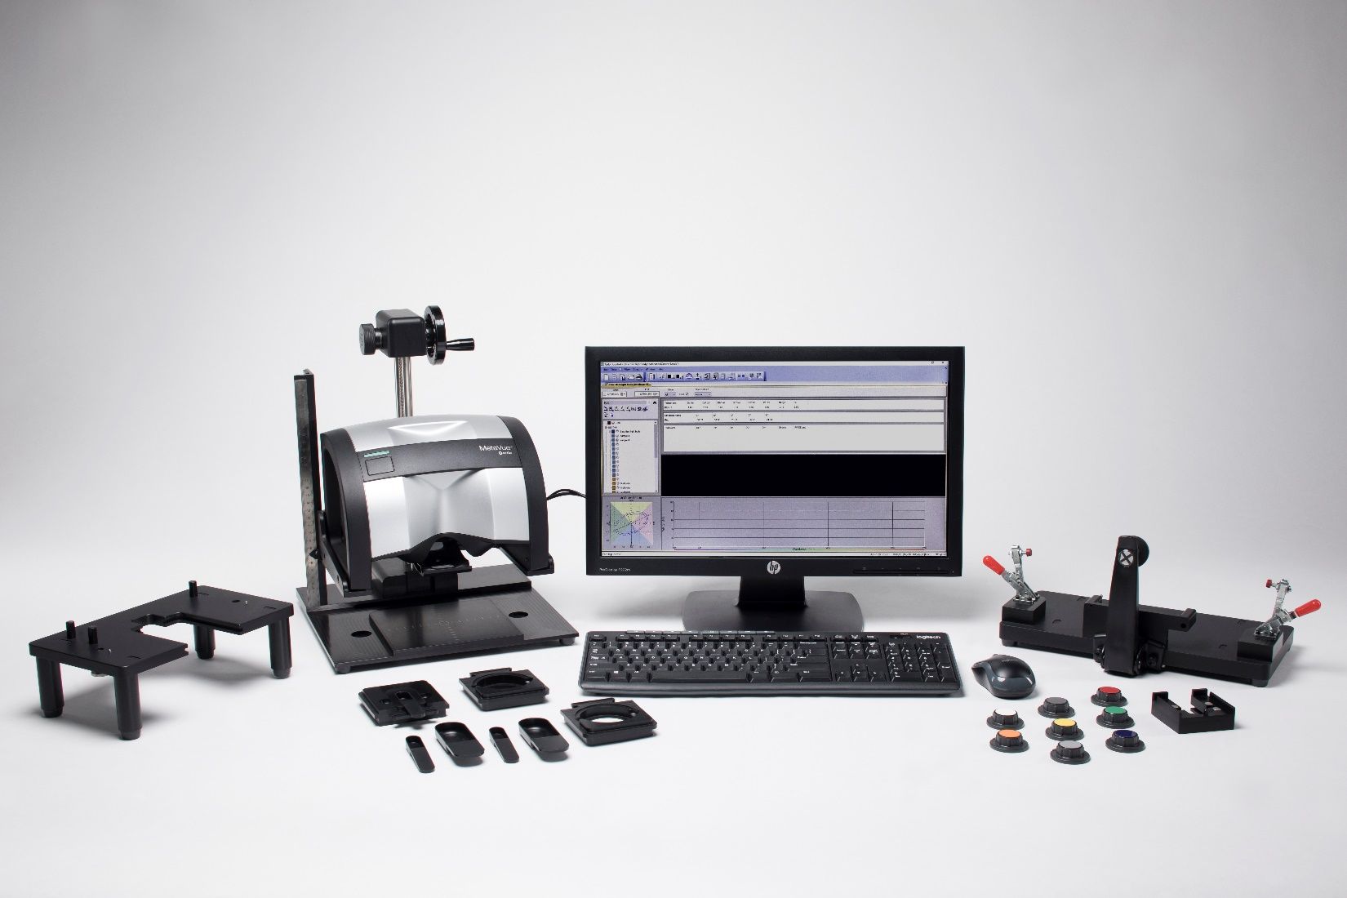
Unmatched Versatility
MetaVue VS3200
Unique capabilities streamline measurements in lab and quality control operations.
Aperture size (2mm to 12mm)
Non-contact measurement
On-screen targeting
Powerful software
Adaptable accessories
Instrument stand
Adjustable stand
Benchtop stand
Notes:
Unmatched Versatility Features:
Aperture Sizes: Ability to measure a wide variety of samples, both small and large shaped, with more flexibility and ease.
Non-contact measurement: Stand out from the competition with non-contact capabilities, allowing you to measure difficult samples like liquids, pastes, powders, and gels, without damaging the sample or contaminating the instrument.
The on-screen targeting provides precise digital targeting, allowing you to quickly and easily select the exact target area being measured. The live video preview allows you to change the size and location of the target area in real time, and magnifies the image for accurate viewing.
You’re able to adjust the target size from 2mm to 12mm.
Overall, this gives you the ability to measure the desired portion of the sample with precision
Powerful software: Integrates with Color iMatch and/or Color iQC to ensure fast qc and colorant formulation.
Adaptable accessories: Instrument Stand, Adjustable Stand, Benchtop Stand

Slide 4
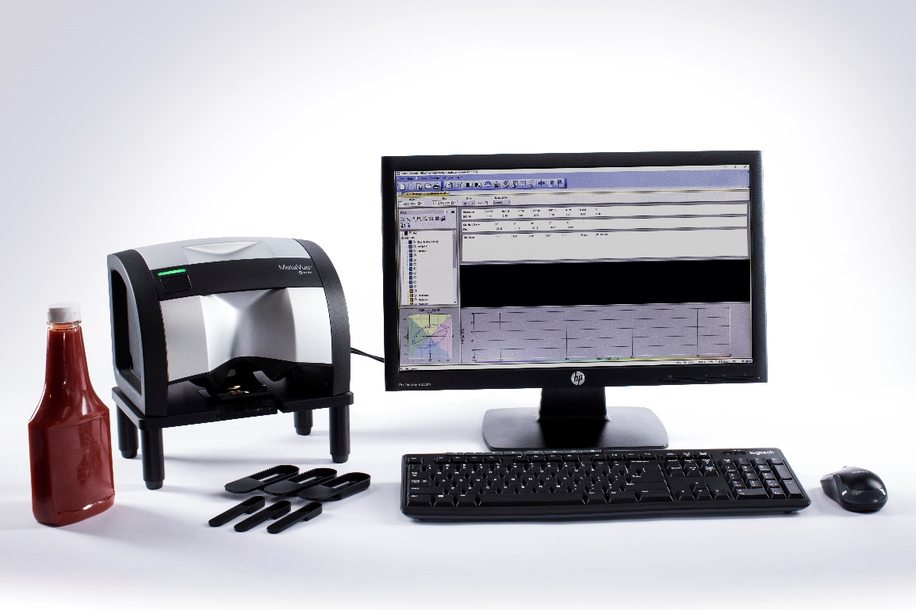
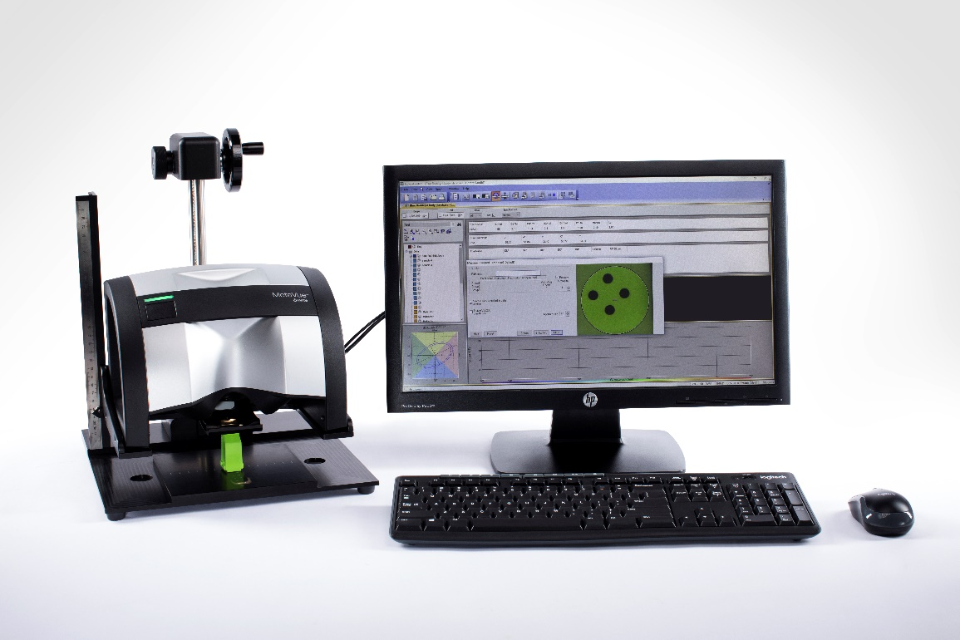
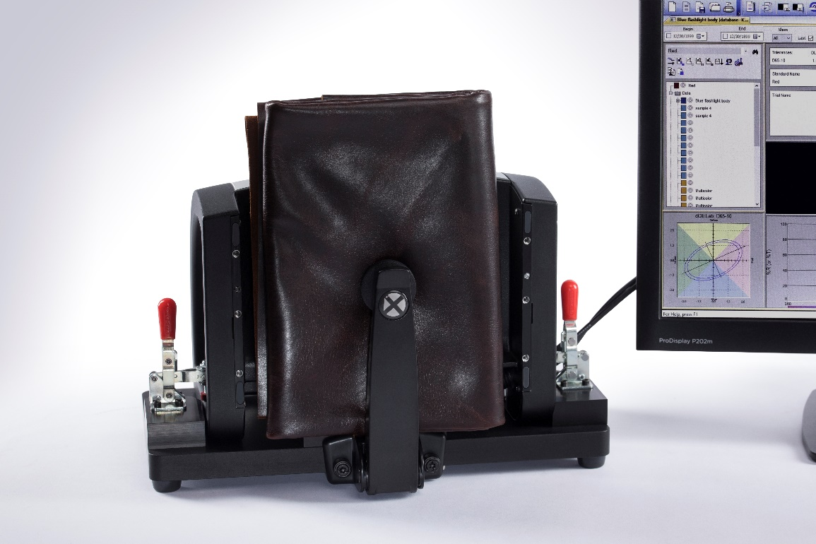
Adaptable Accessories
Instrument Stand
Adjustable Stand
Benchtop Stand
Notes:
Instrument Stand: Places the instrument 3” off the table. Replaceable trays slide in and out, allowing for easy measurement of pastes, powders, and liquids.
Adjustable Stand: Ensures an accurate measurement of samples of varying thickness
Benchtop Stand: Turns the instrument into a benchtop with a samples arm, and enables you to standardize the measurement process of objects like plastic parts.

Slide 5
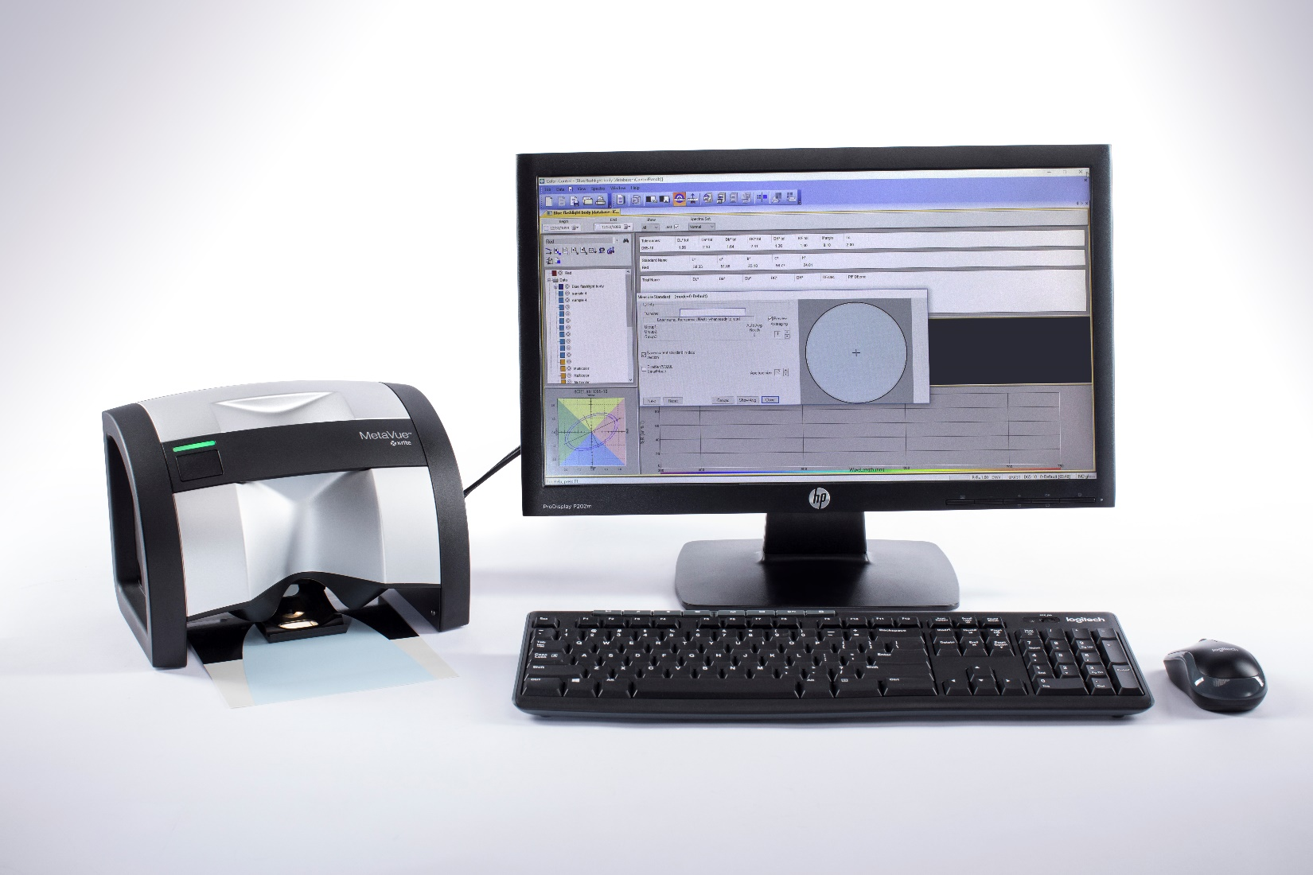
Accuracy
MetaVue VS3200
Superior Measurement Performance
On-screen targeting
Smart spot
3 illuminators
Location aware sample positioner
Sample positioning
Adaptable accessories
Instrument stand
Adjustable stand
Benchtop stand
Notes:
MetaVue provides you with superior measurement performance
The on-screen targeting provides precise digital targeting, allowing you to quickly and easily select the exact target area being measured. The live video preview allows you to change the size and location of the target area in real time, and magnifies the image for accurate viewing.
You’re able to adjust the target size from 2mm to 12mm.
Overall, this gives you the ability to measure the desired portion of the sample with precision
The advanced image processing compensates for texture, gloss, and other appearance effects. This feature is useful for fabrics, vinyl, or carpet.
An example of how this is useful would be to eliminate shadows and highlights when measuring. It also improves color matching on difficult samples.
Advantage over VS450: 3 illuminators – more even illumination on the sample during measurement and more forgiving with poorly positioned or directional samples.
Location aware sample positioner – prevents calibration mistakes because the device ensures sample positioner is the correct location before calibration is performed.
Sample positioning – improved mechanical design of sample positioner flattens thin samples and keeps all samples in proper location for best measurement.
Adaptable accessories – for very challenging samples, the stands ensure consistent placement and measurement.

Slide 6
Ease of Use
MetaVue VS3200
A simple interface that is quick and easy to learn, reducing mistakes and waste.
On-screen targeting
Store sample images
Retractable location-aware sample positioner
Intuitive user interface
Notes:
The simple interface is quick and easy to learn, reducing mistakes and waste.
The on-screen targeting, as previously mentioned, allows you to easily select the exact target area being measured.
Store sample images: provides measurement audit trail and easy retrieval of images for future reference.
Retractable location-aware sample positioner: improves user experience; easy to clean.
Intuitive user interface: front panel button and status indicator reduce operator learning curve, eliminating errors and waste.
The redesigned sample positioner provides the following benefits: location aware- retractable, and it is able to flatten samples.
It is also a better user experience, since it is easier to clean, and more forgiving with samples that are bent or folded.
Calibration: Built in media placement to ensure calibration is done correctly, eliminating errors.
The intuitive user interface includes a front panel button and status indicator, which both help to reduce operator learning curve, eliminating errors and waste.

Slide 7
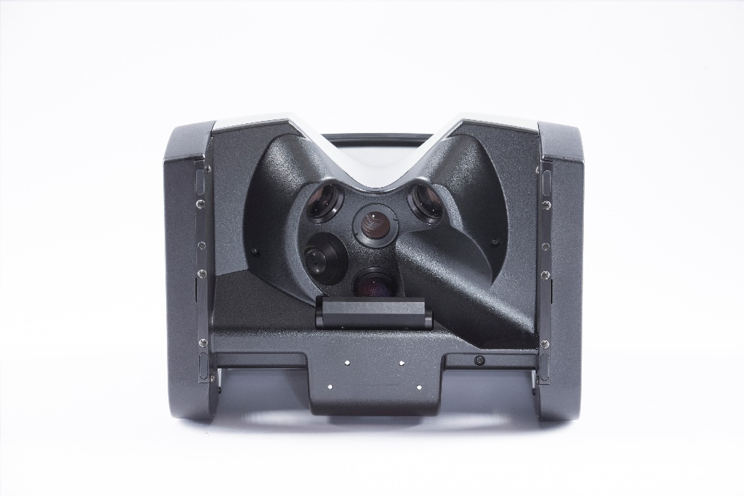
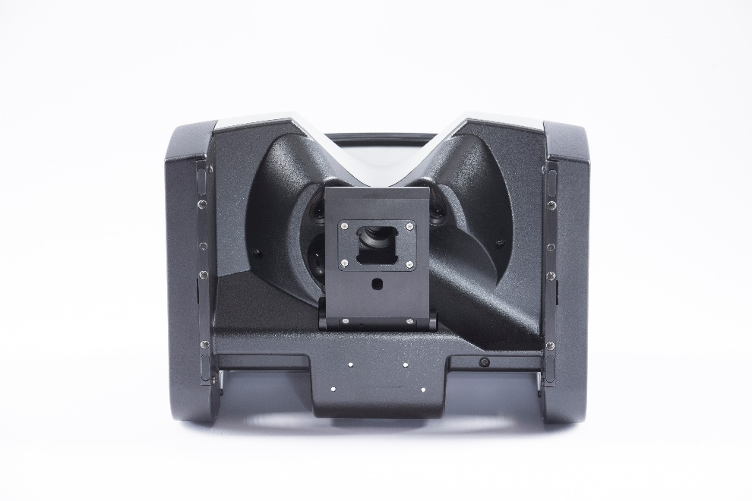
Seamless Integration
MetaVue VS3200
Easily adapt instrument to existing X-Rite workflows.
Data compatible
Store sample images
Workflow integration via Color iQC / iMatch
Includes green check tile and calibration certificate
NetProfiler
Notes:
MetaVue allows you to easily adapt to your existing X-Rite instrument.
It is data compatible with the X-Rite VS450 and 964 data for faster integration, eliminating the need to build new databases.
Provides measurement audit trail and easy retrieval of images for future reference with the ability to store sample images.
Workflow integration via Color iQC / iMatch – jobs (check out the website for some copy).
The purchase of MetaVue includes a green check tile and calibration certificate.
Green check tile: verify instrument performance over time.
Calibration certificate: documents performance of the instrument.
Compatible with NetProfiler, enabling you to verify and optimize instrument performance – all to enhance the measurement performance.

Slide 8
Key Features
User Selected Spot
On-Screen Targeting
Gloss Sensor
Smart Spot Processing
Status Indicator
Spectral Image Sensor
Measurement Button
Cable
Routing
Kensington Lock
Grip Points
LED Illuminators
Sample Positioner
Grips Points
Notes:
On-Screen Targeting – Enables operator to avoid artifacts in the sample and to precisely define what part of the sample to measure.
User-Selected Spot – Measure an area as small as a 2mm circle.
Measurement Button – Initiate measurement on device, helpful with awkward and large samples. Operator may also initiate measurement via software.
Status Indicator – Multi-colored indicator makes instrument status clear (blue = starting up or low power state, red = calibration required, green = ready to measure)
Gloss Sensor – Instrument measures 45° gloss.
Spectral Image Sensor – Device captures full spectral image, which enables improvements in versatility, ease of use, and performance.
Smart Spot Processing – Compensation for appearance effects to make color reading more closely agree with human visual perception.
Kensington Lock – Option to secure the device.
Cable Routing – Convenient mechanism to keep cables out of the way.
Grip Points – Multiple methods to adjust the position of the device.
Sample Positioner – Flattens samples to maximize measurement performance. Instrument knows location of sample positioner to prevent mistakes during calibration or measurement. Sample positioner retracts for easy cleaning of lenses.
LED Illuminators – Three broadband illuminators provide even illumination, yet can be individually controlled to assess texture of sample.

Slide 9
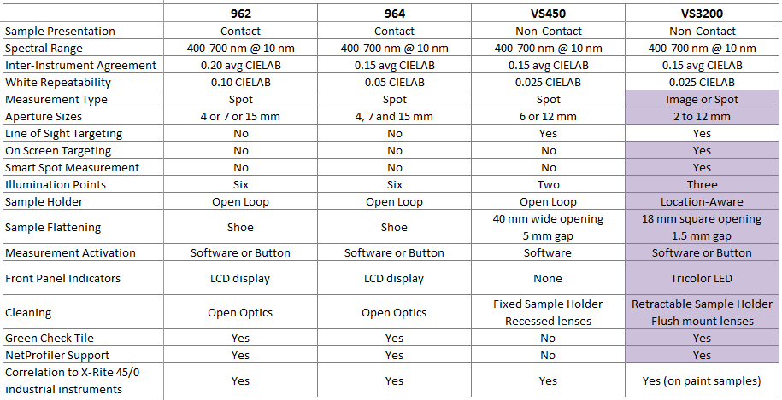
Key Differentiators
Notes:
Points of Emphasis
Spectral image capture – Utilizes a camera for on screen targeting, eliminating errors and rework.
2-12 mm aperture size – Ability to measure a wide variety of samples, both small and large shaped, with more flexibility and ease.
On screen targeting – Enables operator to avoid artifacts in the sample and to precisely define what part of the sample to measure.
Store sample images – Provides measurement audit trail and easy retrieval of images for future reference with the ability to store sample images.
Improved illumination system – The three illuminators provide even illumination on the sample during measurement and is more forgiving with poorly positioned or directional samples.
Green check tile – Verify instrument performance over time.
Calibration certificate – Documents performance of the instrument.
NetProfiler – Enables you to verify and optimize instrument performance – all to enhance the measurement performance.
Adjustable Accessories – Instrument stand, adjustable stand, and benchtop stand

Slide 10
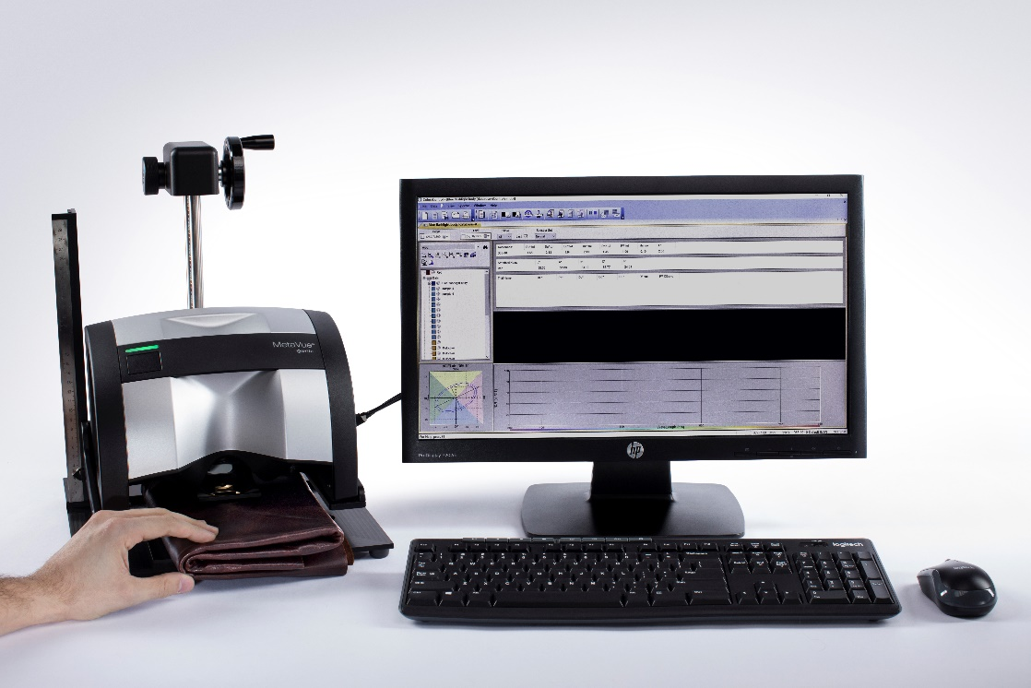
Powerful Software
Color iMatch
Color iQC
Formulation Software
Quality Assurance Software
One-hit matches
Reduce color formulation time
Improve operator efficiency
Portable jobs
Define templates
Remote output feature
Notes:
Color iMatch: A job-oriented color formulation solution enabling fast, accurate color analysis and colorant formulation for a variety of applications.
Achieve one-hit matches practically every time with multi-flux based program, reducing turnaround time by half or more.
Reduce color formulation time and costs with spectral matching.
Improve operator efficiency with simple user interface and workflow prompts to guide the operator through the process.
Color iQC: A job-oriented color quality control solution designed to meet evolving color measurement and management requirements in all industrial market segments.
Job-based solution leveraging portable jobs that contain color data and all criteria necessary for color management decisions, enabling all stakeholders to see data consistently across the color workflow.
Define templates to establish common processes or materials, including pre-defined standards, tolerances, settings and displays to ensure operational consistency.
Use the remote output feature to tailor and format any color data in order to seamlessly share consistent information with color partners.

Slide 11
NetProfiler
NetProfiler
Quality Assurance Software
Standardization of color acceptance criteria
Profile a wide range of instruments
Sophisticated monitoring tools
Automatic reminders
Notes:
NetProfiler is a cloud-based blend of software and color standards for verifying and optimizing performance of color measurement devices, reducing variance among instruments.
Enables standardization of color acceptance criteria and quality across locations.
Profile a wide range of instruments with or without an Internet connection to ensure accurate performance.
Sophisticated monitoring tools can be configured to run on a regular basis for preventative maintenance to detect uncertainties, potential problems and instruments that need servicing to minimize waste and rework due to color issues.
Benefit from automatic reminders when an instrument needs profiling, with a centrally controlled enterprise-wide instrument management process that ensures all instruments are performing at peak levels.

Slide 12
MetaVue VS3200

Slide 13
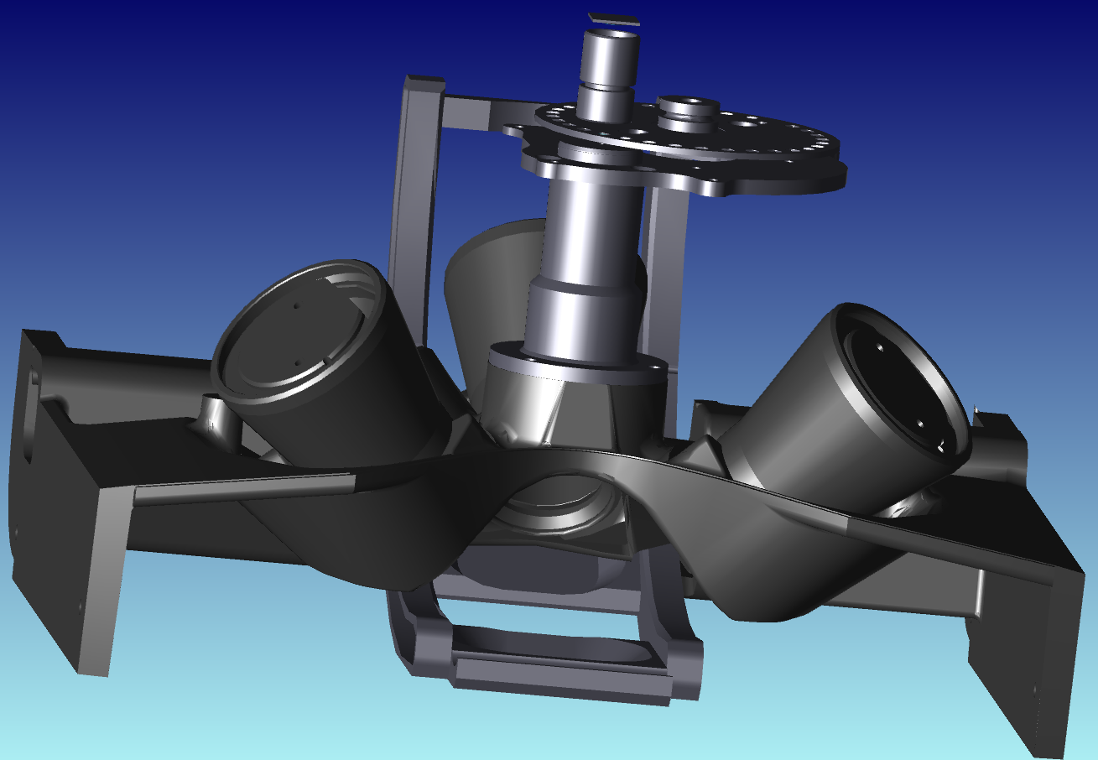
Optical Engine
Camera Sensor
Gloss Sensor
Filter Wheel
Sample Positioner
Broadband illumination

